Slide 1
ADVANCED DATABASE SYSTEMS
Daniel linden & Johannes Sörensen

Slide 2
General information
28 October, Victoriastadion 2C/2D 0800-1300
You are allowed to bring the course book and all of Erdogan’s lecture slides.
You are NOT allowed to bring Bo’s lecture slides, (nor this presentation).

Slide 3
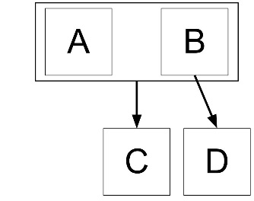
2NF – No partial dependencies
The relation must be in 1NF and every non-primary attribute must be fully functionally dependent on all candidate keys.
A non-primary attribute, is an attribute that is not part of any candidate key.
Violation of 2NF:
R(A,B,C,D)
{A,B} → C
B → D
CK: {A, B}
P: A, B
NP: C, D
D is only dependent on a subset of the candidate key {A,B}.

Slide 4
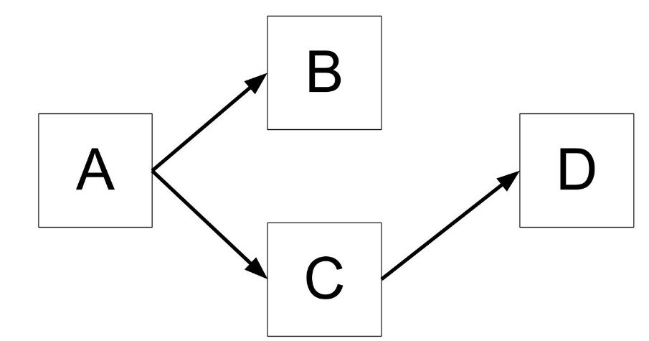
3NF – No transitive dependencies
The relation must be in 2NF and no non-primary attributes are allowed to determine other non primary attributes – i.e. no non-primary attributes are allowed to be transitively determined by a candidate key.
Violation of 3NF
R(A,B,C,D)
A → {B, C}
C → D
CK: A
P: A
NP: B, C, D
D is determined by C, both of which are non-primary attributes!

Slide 5

BCNF
The relation is in 1NF and for every non-trivial, fully functional dependency: all determinants must be candidate keys.
Violation of BCNF
R(A,B,C,D)
CK: AC, BC, DC
P: ABCD
NP: -
A, B, and D are BY THEMSELVES not candidate keys!

Slide 6
Tips och Tricks
Relations with no composite keys are always automatically in AT LEAST 2NF
Relations with no non-primary attributes are always AT LEAST in 3NF
Trivial dependencies cannot cause violations against normal forms.
Example:
A → A
{A, B} → B

Slide 7
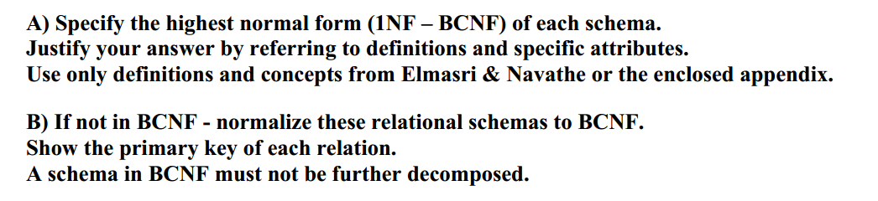
Task 1

Slide 8
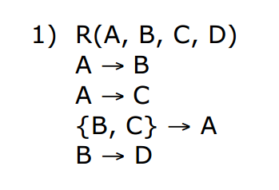
Task 1 - 1
CK: A, {B,C}
P: A,B,C
NP: D
D is determined by a subset of CK {B,C}, therefore the relation is in 1NF!

Slide 9
Task 1 - 1
CK: A, {B,C}
P: A,B,C
NP: D
R1 ( A,B,C)
R2( B, D)

Slide 10
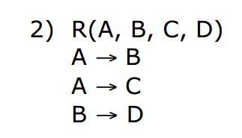
Task 1 - 2
CK: A
P: A
NP: B,C,D
The non-primary attribute D is determined by the non-primary attribute B (transitively), therefore the relation is in 2NF!

Slide 11
Task 1 - 2
CK: A
P: A
NP: B,C,D
R1(A,B,C)
R2(B,D)

Slide 12
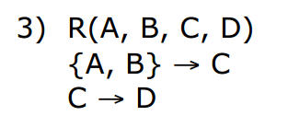
Task 1 - 3
CK: {A,B}
P: A,B
NP: C,D
No partial dependecy, however:
The non-primary attribute D is determined by the non-primary attribute C (transitively), therefore the relation is in 2NF!

Slide 13
Task 1 - 3
CK: {A,B}
P: A,B
NP: C,D
R1(A,B,C)
R2(C,D)

Slide 14
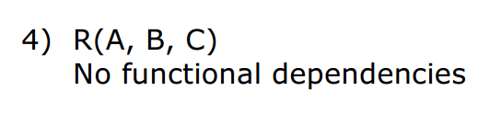
Task 1 - 4
CK: {A,B,C}
P: A,B,C
NP: -
No violations
BCNF!

Slide 15
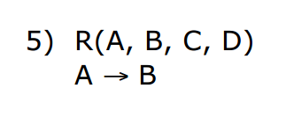
Task 1 - 5
CK: {A,C,D}
P: A,C,D
NP: B
B is determined by a subset (A) of the CK {A,C,D}.
1NF

Slide 16
Task 1 - 5
CK: {A,C,D}
P: A,C,D
NP: B
R1 (A,C,D)
R2( A,B)

Slide 17
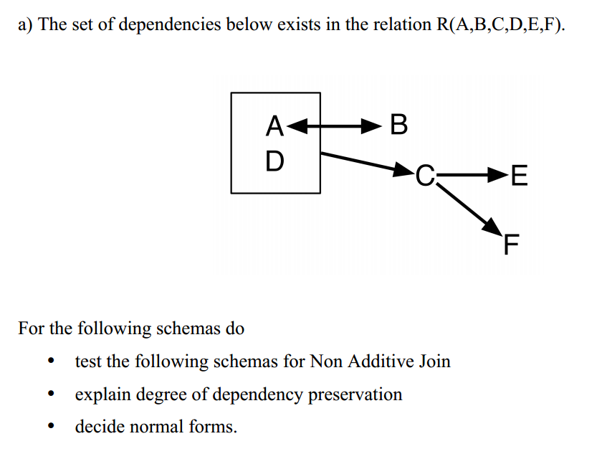
Task 2

Slide 18
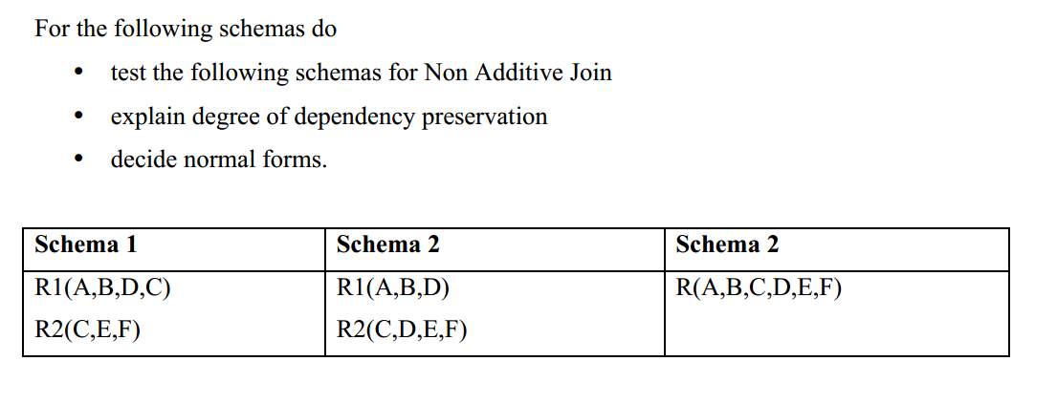
Task 2

Slide 19
Lossless join
U
R1 R2 → R1 – R2
Or
R1 R2 → R2 – R1
U

Slide 20
Dependency preservation
All original dependencies must remain in the decomposed relations
Example
R( A,B,C)
A→B
B→C
2NF
R1(A,B)
R2(B,C)
→

Slide 21
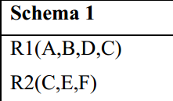
Task 2-1
U
R1 R2 → R1 – R2
…or the common set of attributes must determine the remaining attributes in either R1 or R2.
A → B
B → A
{A,D} → C
C → {E,F}
Ok
Ok
Ok
Ok
One of the following must be true:
C → {A, B, D}
Or
C → {E, F}
NAJ!

Slide 22
Task 2-1
R1
CK: {A,D}, {B,D}
P: A,B,D
NP: C
All determinants are not candidate keys – 3NF!
A → B
B → A
{A,D} → C
C → {E,F}
R2
CK: C
P: C
NP: E,F
BCNF

Slide 23
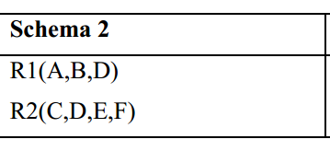
Task 2-2
A → B
B → A
{A,D} → C
C → {E,F}
Ok
Ok
Not Ok
Ok
One of the following must be true:
D → {A, B}
Or
D → {C, E, F}
Does neither have dependency preservation, nor non-additive join
Lossy join

Slide 24
Task 2-2
R1
CK: {A,D}, {B,D}
P: A,B,D
NP: -
All determinants are not candidate keys – 3NF!
A → B
B → A
{A,D} → C
C → {E,F}
R2
CK: {C,D}
P: C,D
NP: E,F
Partial dependency (E,F) – 1NF

Slide 25
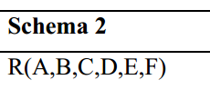
Task 2-3
A → B
B → A
{A,D} → C
C → {E,F}
Tests for dependency preservations and non-additive joins require decompositions
CK: {A,D}, {B,D}
P: A,B,D
NP: C, E, F
2NF (E,F are transitively determined)
3

Slide 26
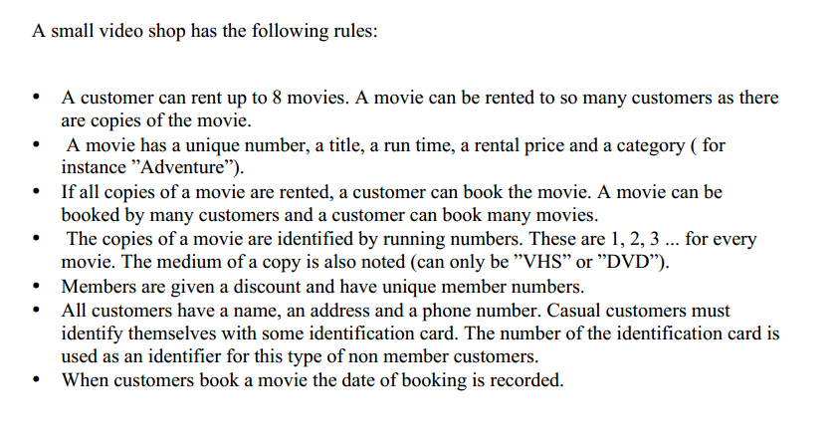
Task 3

Slide 27
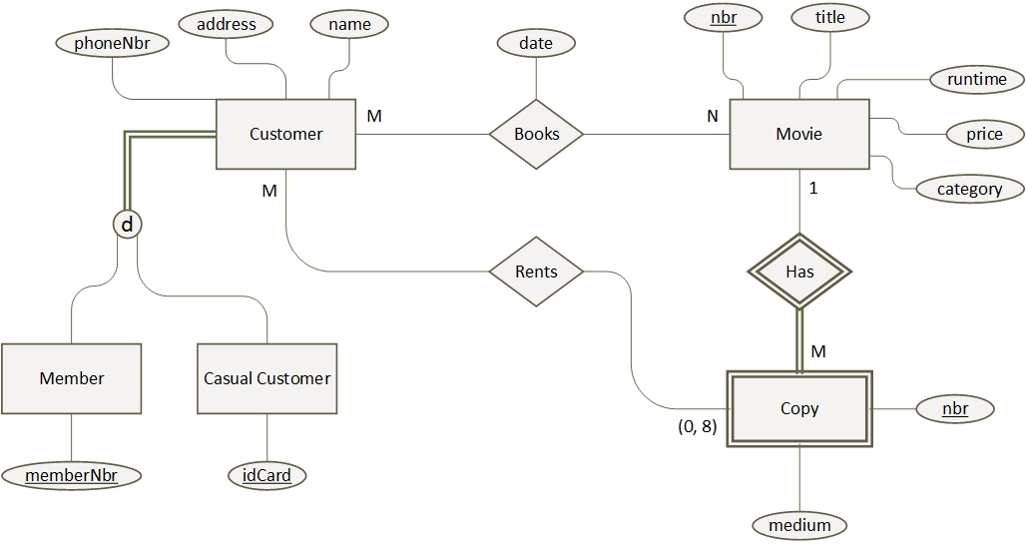
Task 3

Slide 28
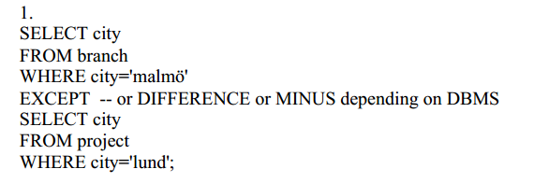

Task 4 -1

Slide 29
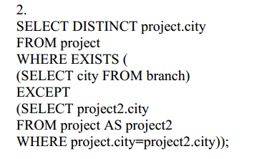
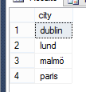
Task 4 -2

Slide 30
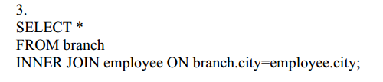
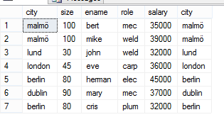
Task 4 - 3

Slide 31
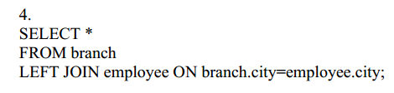
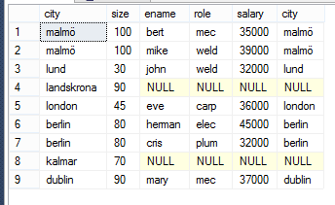
Task 4 - 4

Slide 32
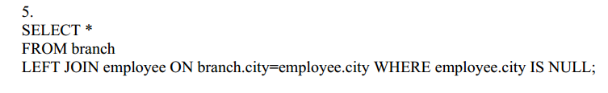

Task 4 - 5

Slide 33
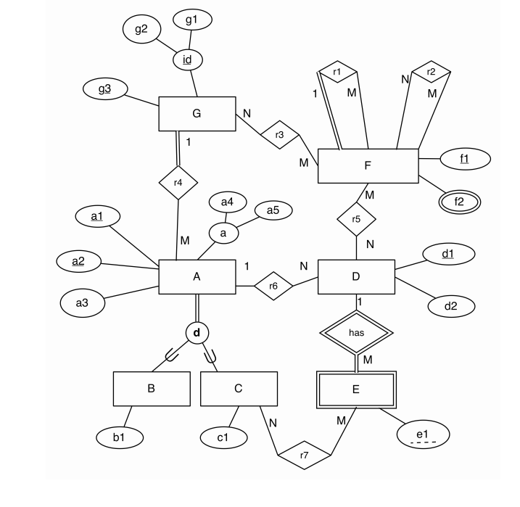
Task 5

Slide 34
Task 5 – Solution in seperate file!

Slide 35
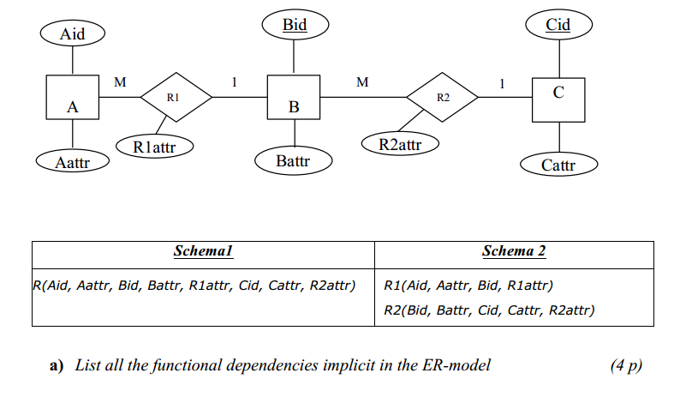
Task 6

Slide 36
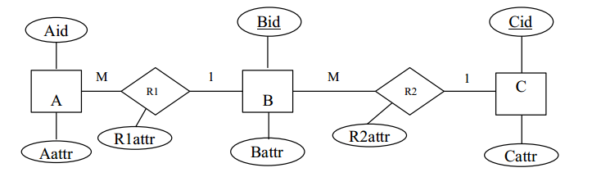
Task 6
Aid → {Aattr, Bid, R1attr}
Bid → {Battr, Cid, R2attr}
Cid → Cattr

Slide 37

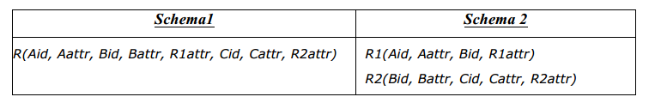
Task 6 - 1
Aid → {Aattr, Bid, R1attr}
Bid → {Battr, Cid, R2attr}
Cid → Cattr
True

Slide 38

Task 6 - 2
Aid → {Aattr, Bid, R1attr}
Bid → {Battr, Cid, R2attr}
Cid → Cattr
True

Slide 39

Task 6 - 3
Aid → {Aattr, Bid, R1attr}
Bid → {Battr, Cid, R2attr}
Cid → Cattr
True

Slide 40
Task 6 - 4
Aid → {Aattr, Bid, R1attr}
Bid → {Battr, Cid, R2attr}
Cid → Cattr
False

Slide 41
Task 6 - 5
Aid → {Aattr, Bid, R1attr}
Bid → {Battr, Cid, R2attr}
Cid → Cattr
False

Slide 42

Task 6 - 6
Aid → {Aattr, Bid, R1attr}
Bid → {Battr, Cid, R2attr}
Cid → Cattr
False

Slide 43
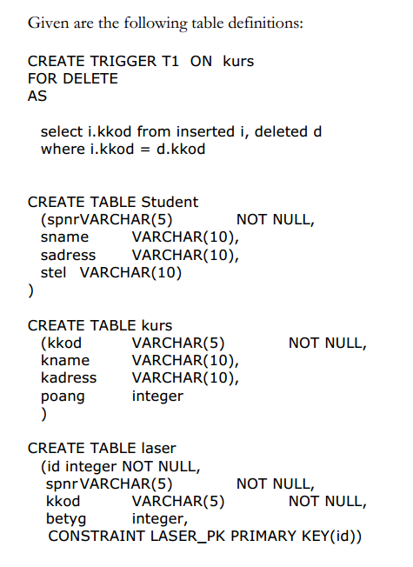
Task 7

Slide 44
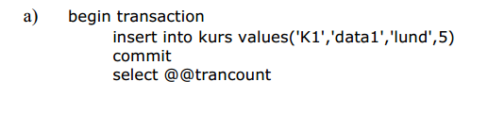

Task 7-A

Slide 45
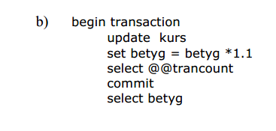


Task 7-B
From kurs
Error, there is no column called ”betyg”, we have, however, assumed that this is a typo
The 5 is if you include the last statement in the result

Slide 46
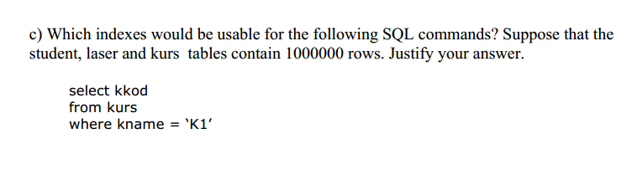
Task 7-C
Assumption: If kname is the primary key of the relation, no indexes are needed.
If not, an index on kname is useful
This will cause faster selects, yet slower update, insert, delete

Slide 47
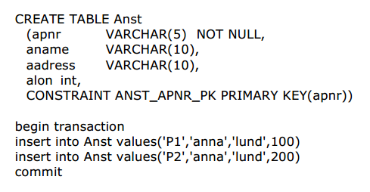
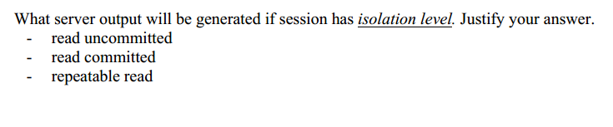
Task 8

Slide 48
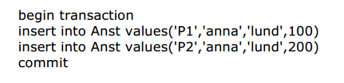
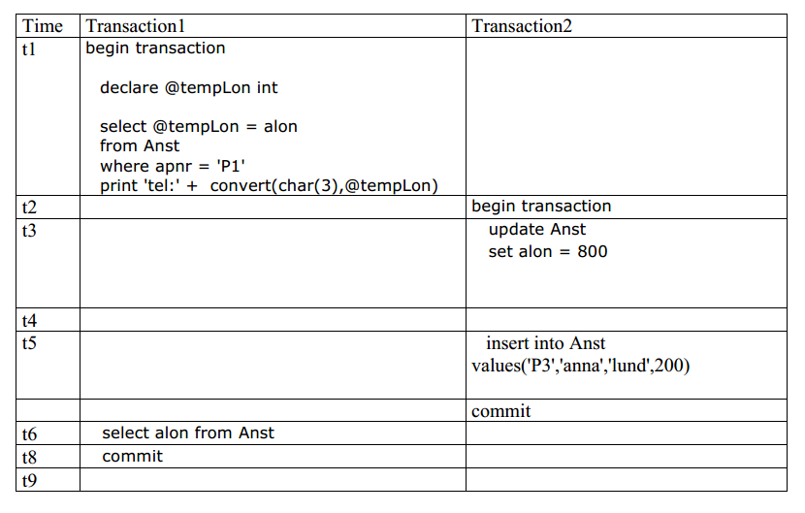


Task 8 - 1

Slide 49
Task 8 – 2

Slide 50

Task 8 – 3

Slide 51
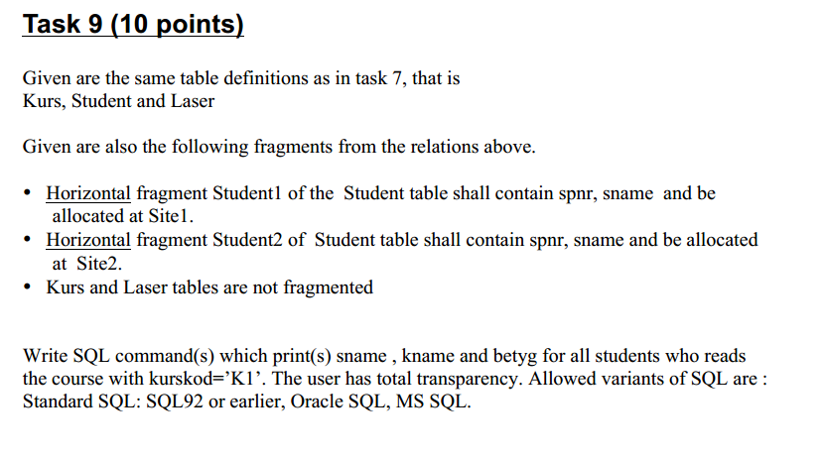
Task 9

Slide 52
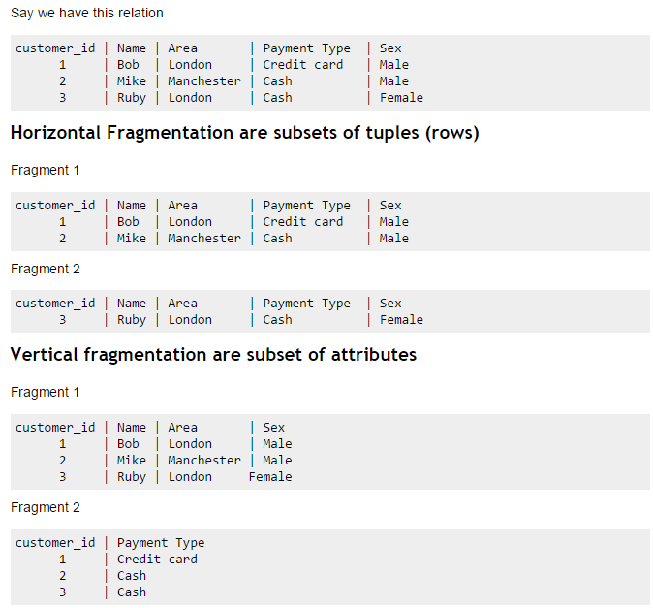
Task 9 – Fragments

Slide 53
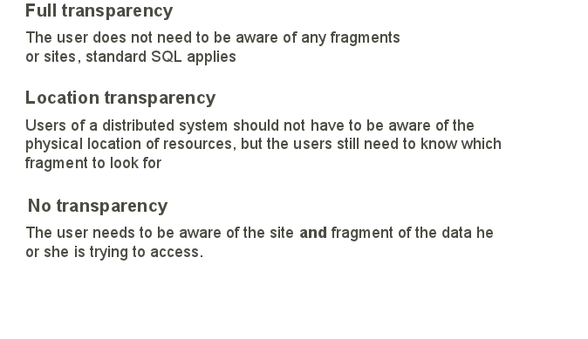
Task 9
(Or complete transparency)
(Or replication transparency)
See also Erdogans lecture about Distributed databases (F12-F13), slide 9-18)

Slide 54
Task 9 – Full transparency
select sname, kname, betyg
from laser l, kurs k, student s
where l.kkod = k.kkod
and s.spnr = l.spnr
and l.kkod = 'k1'
Where:
Virtual table
select subquery.sname, k.kname, subquery.betyg
from (select l.kkod, s.sname, l.betyg
from student s
join laser l
on s.spnr = l.spnr
) subquery
join kurs k
on k.kkod = subquery.kkod
where k.kkod = 'k1'

